Slide 1


Founding Airbnb
in New York
201433706 Lee Halim
201635825 Oh Seongwon
201835524 Jeong Yuni

Slide 2
Contexts
01
Object
02
Data
03
Data preprocessing
04
Role
05
Schedule

Slide 3



Object
Estimation of room price according to various conditions when registering room with Airbnb in New York City

Slide 4
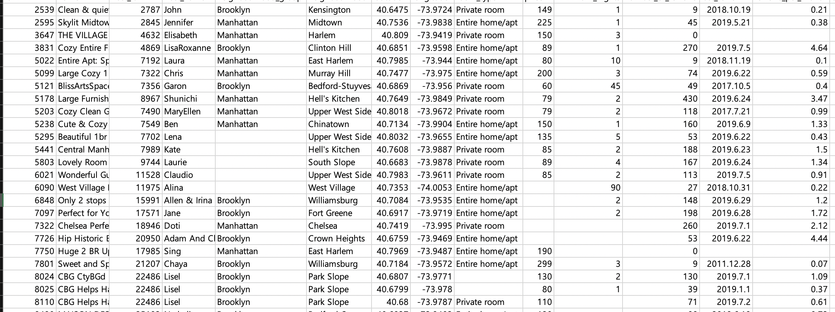
Data
Missing Data
Size – 48896 rows
Category – 16
Target - Price

Slide 5
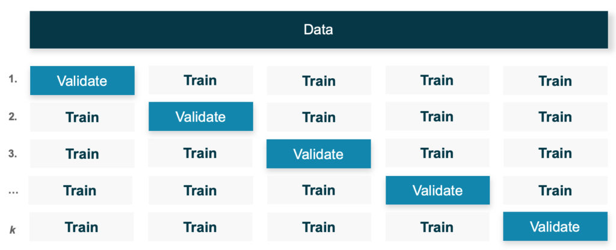
Preprocessing
Check dataset
Data cleaning
Missing value treatment
Data scaling
- Min-max scaling
4. Develop prediction model
- k-fold Cross Validation (CV)

Slide 6



Role
Lee Halim
Work Together
Data Curation / Data Inspection
Data preprocessing ( cleaning / scaling)
Data analysis
Model Evaluation
Oh Seongwon
Jeong Yuni

Slide 7
Schedule
Sun | Mon | Tue | Wed | Tur | Fri | Sat
 | 6/1 | 6/2 | 6/3 | 6/4 | 6/5 | 6/6
6/7 | 6/8 | 6/9 | 6/10 | 6/11 | 6/12 | 6/13
6/14 | 6/15 | 6/16 | 6/17 | 6/18 | 6/19 | 6/20
6/21 | 6/22 | 6/23 | 6/24 | 6/25 | 6/26 | 6/27
6/28 | 6/29 | 6/30 | 7/1 | 7/2 | 7/3 | 7/4
Select Object / Prepare Proposal Presentation
Data Curation / Data Inspection
Data Preprocessing
Data Analysis
Evaluation / Deployment
Prepare Final Presentation
Final Presentation
Prepare Final Presentation

Slide 8
Thank You

